Slide 1
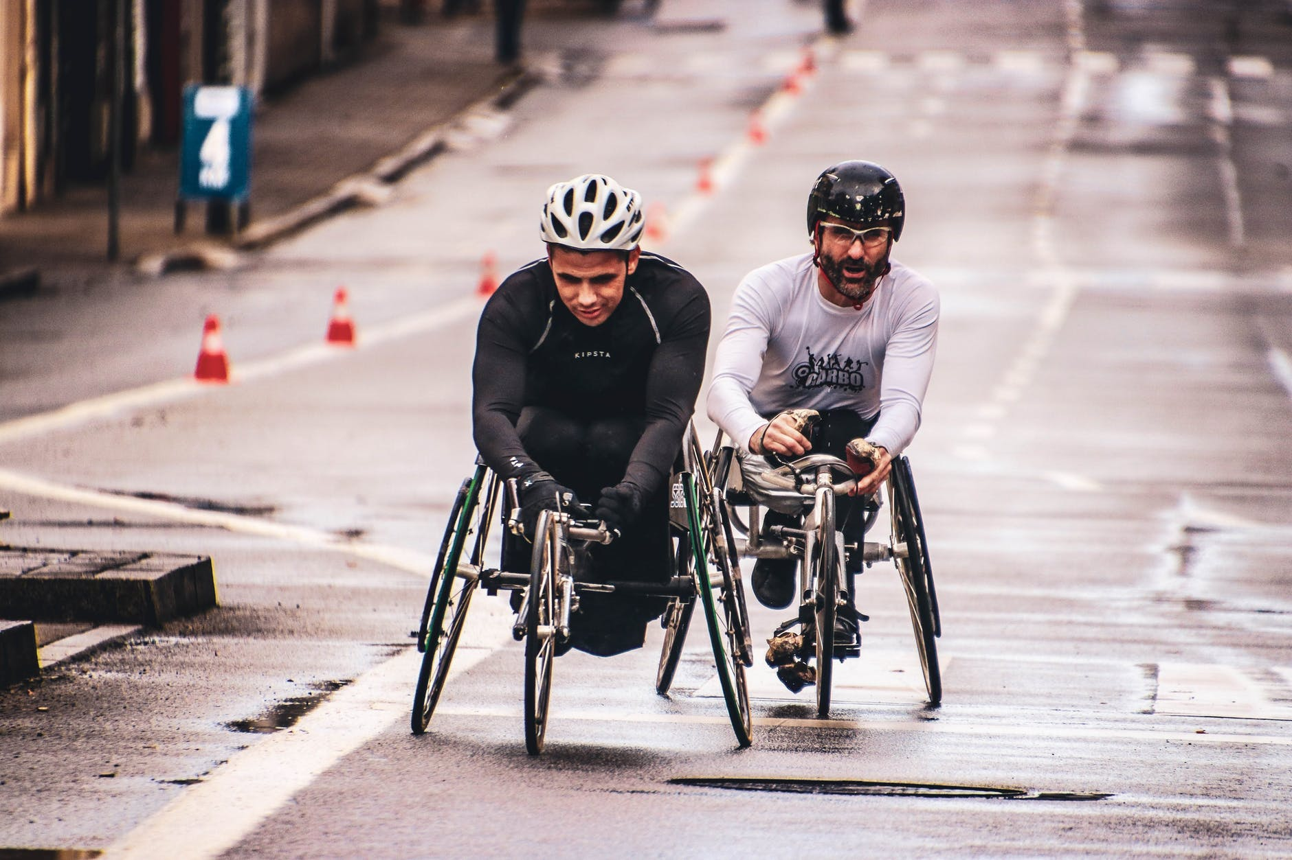
Team-
Decoders

Slide 2
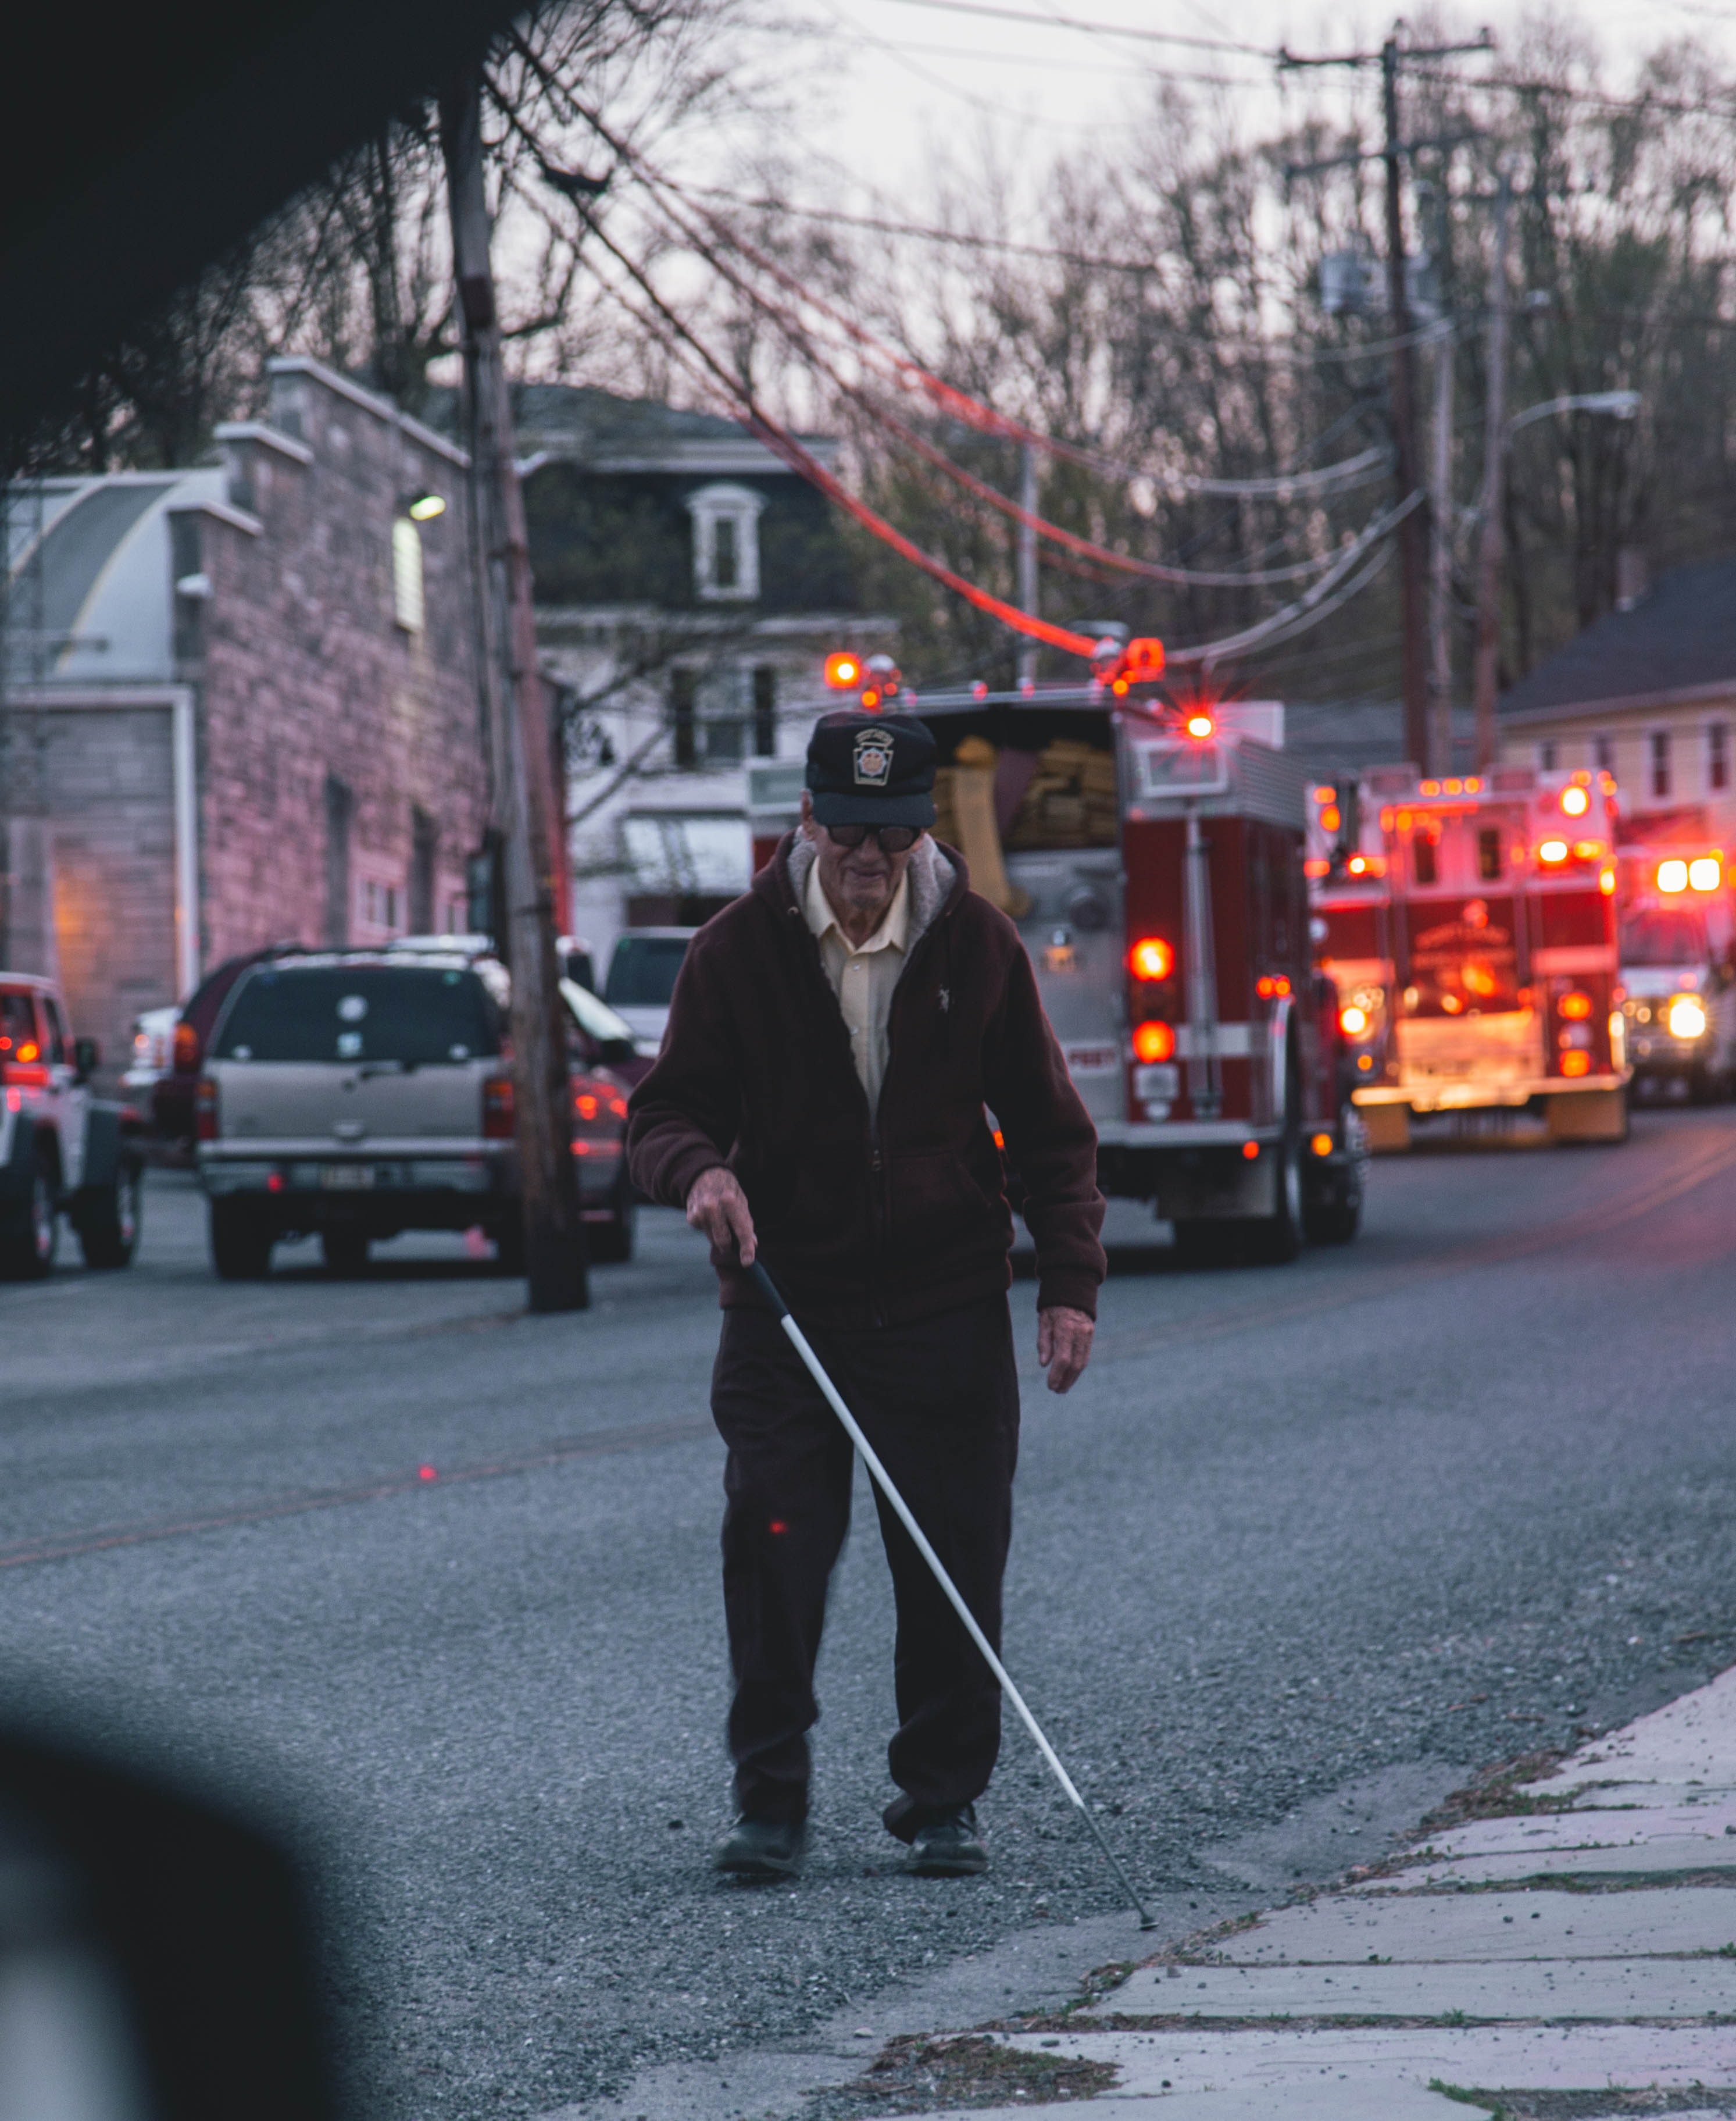




About 25% of the world's population lives with some form of disability, of whom 2-4% experience significant difficulties in functioning including visually and auditory impairment ,learning disabilities, vocal impairment etc
Up to 10 percent of the population are affected by specific learning disabilities, such as dyslexia, dyscalculia and autism. Nearly 285 million people worldwide are visually impaired and 70 million people are mute
There is little affordable assistance devices for differently abled people to make there life more independent

Slide 3
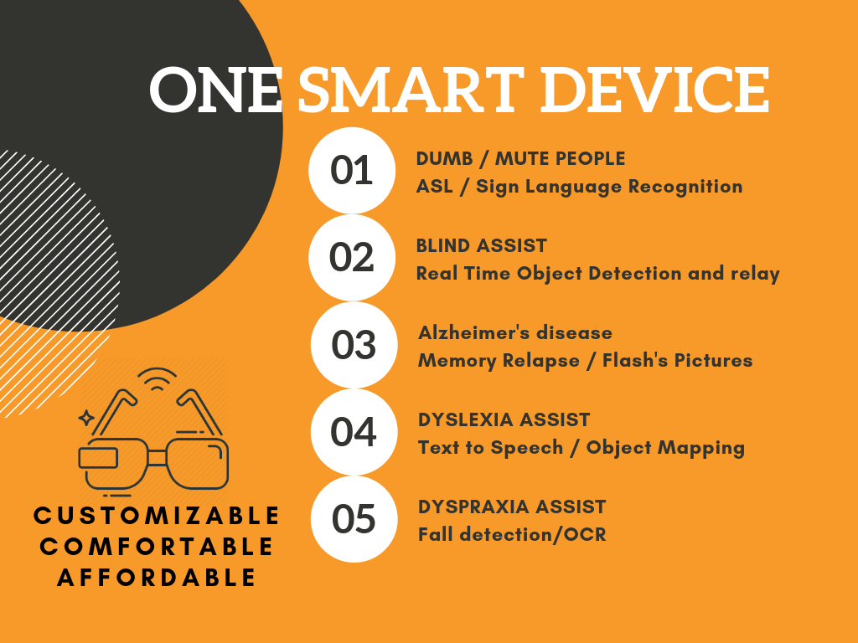

Slide 4
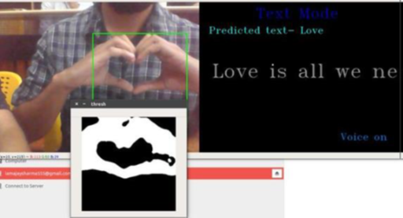
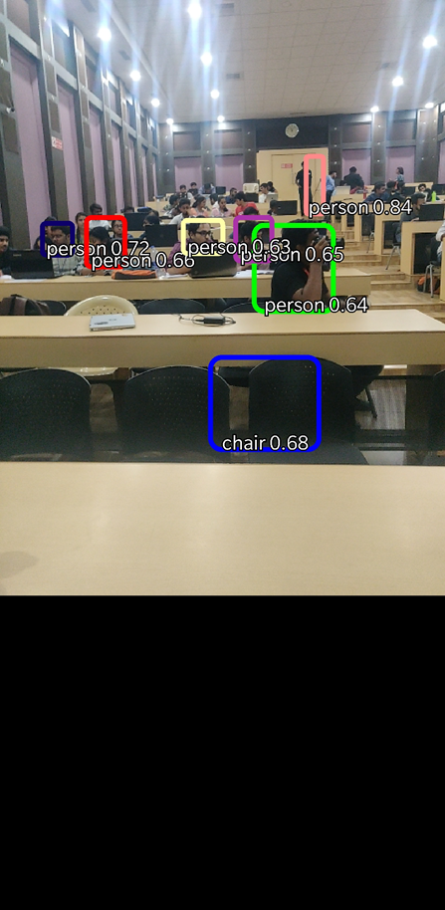
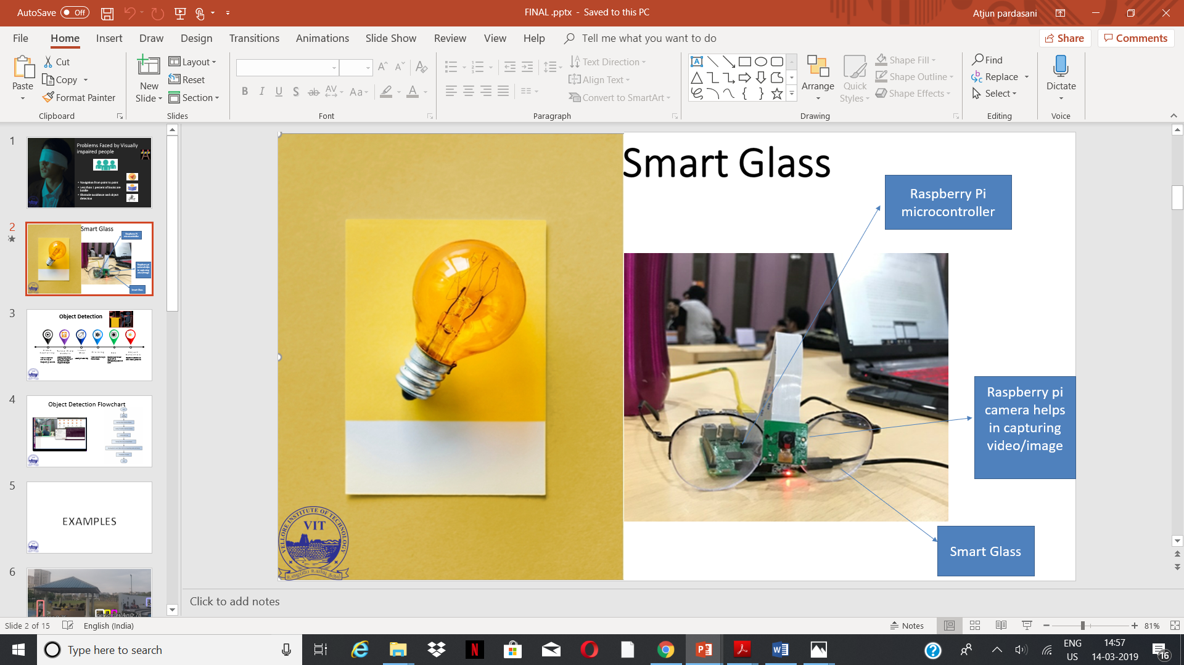
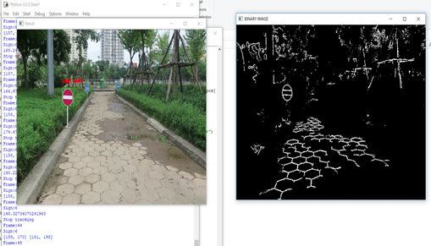
Technology involved
AMERICAN SIGN LANGUAGE TO
SPEECH
Object detection
PATH DETECTION

Slide 5
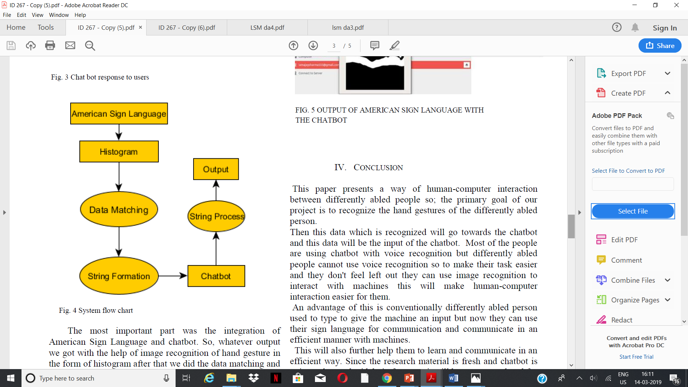
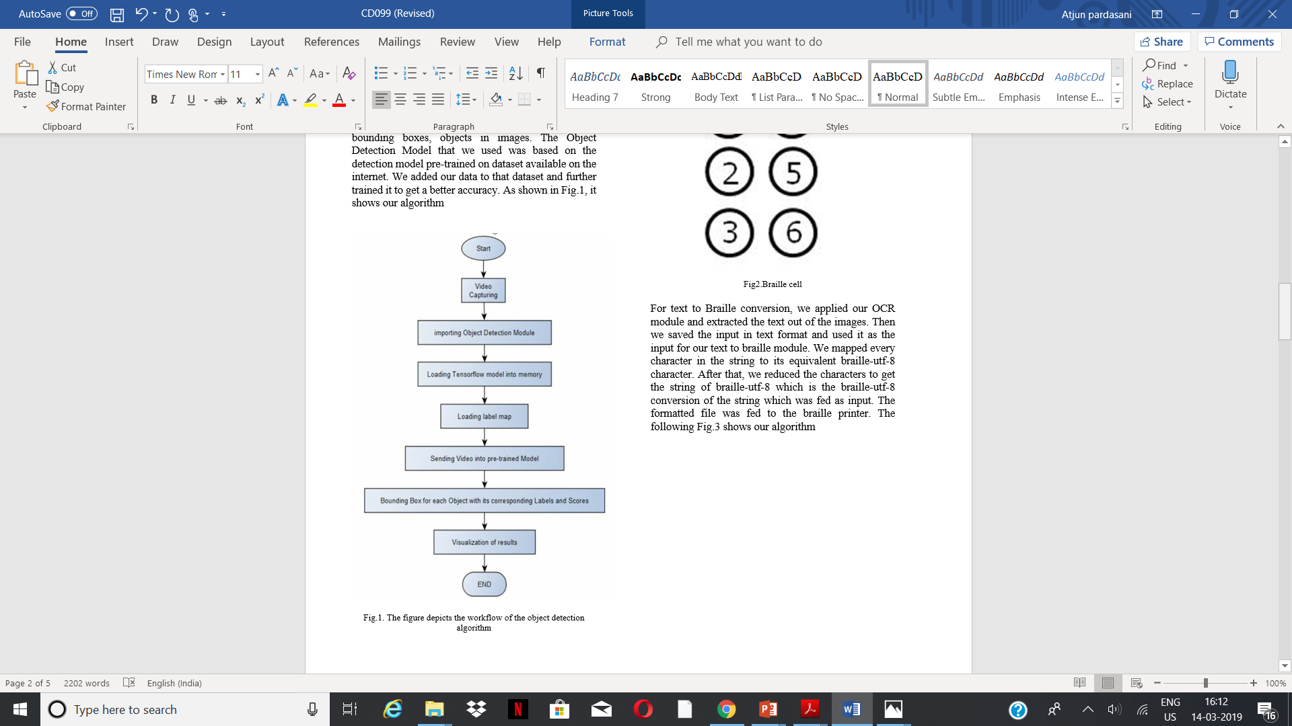
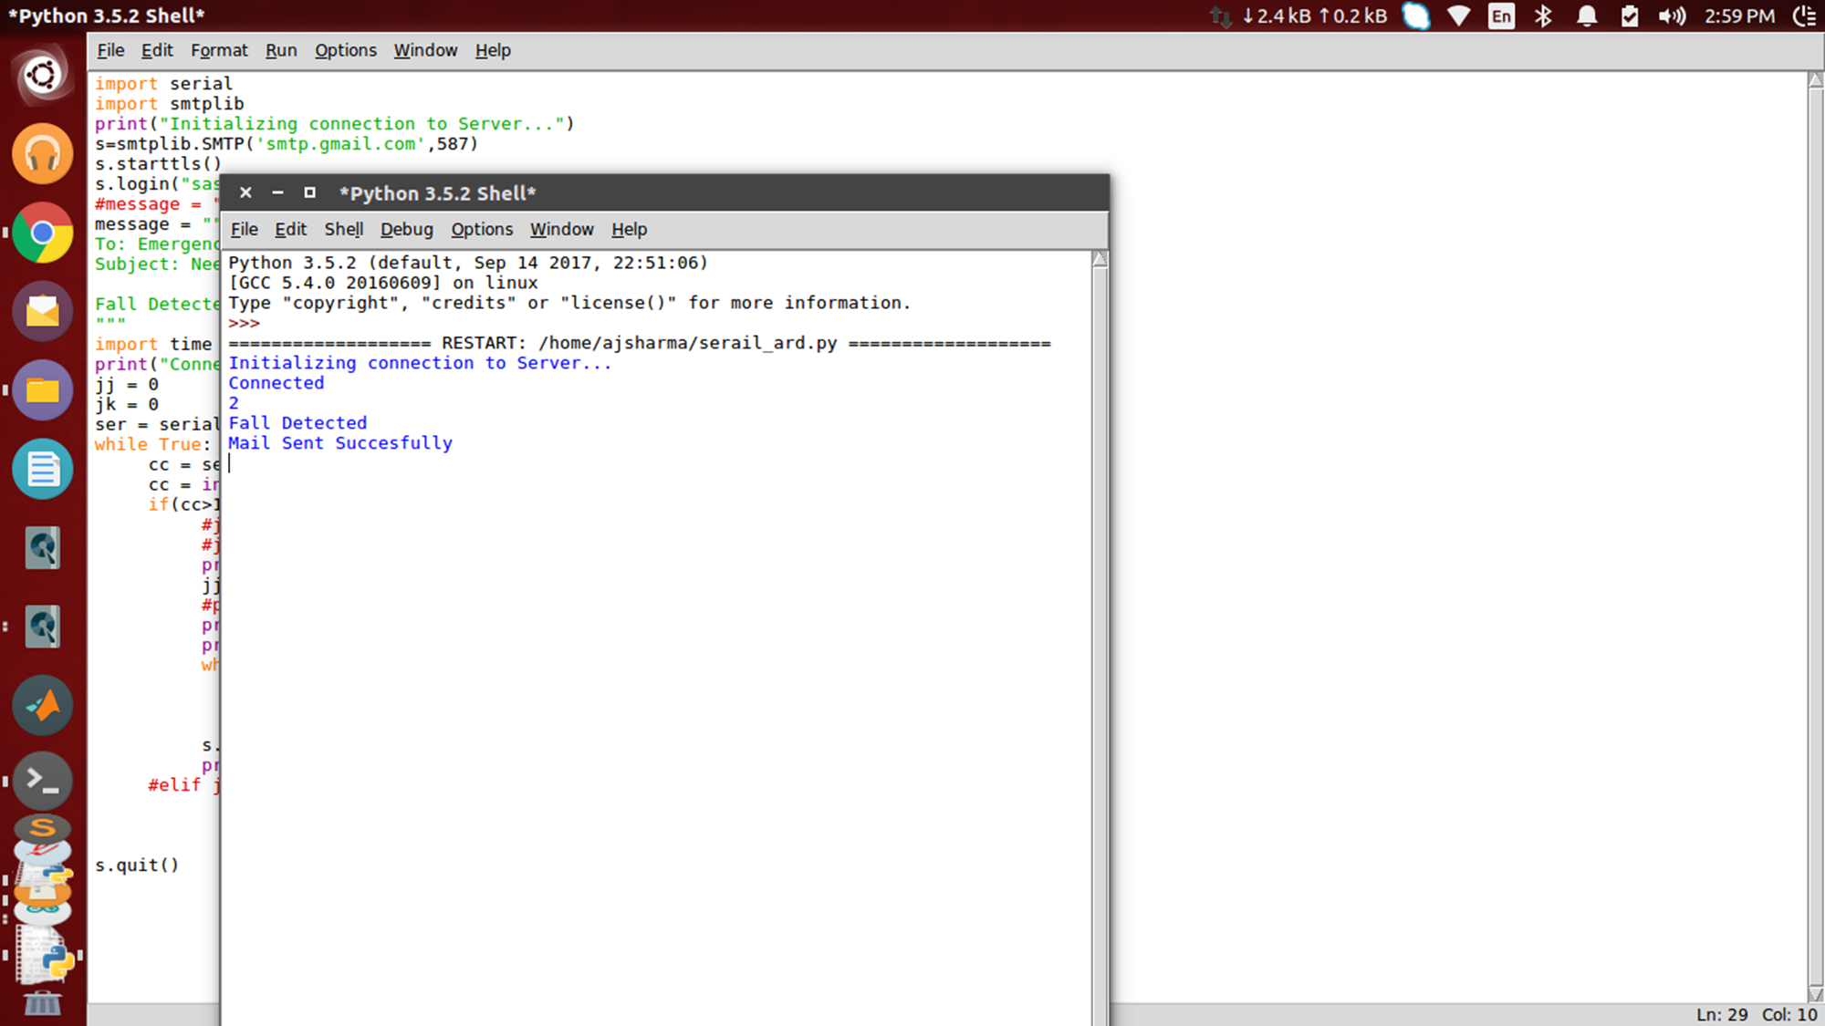
Fall detection for movement impaired people
Object detection for visually impaired
American Sign language for mute people

Slide 6
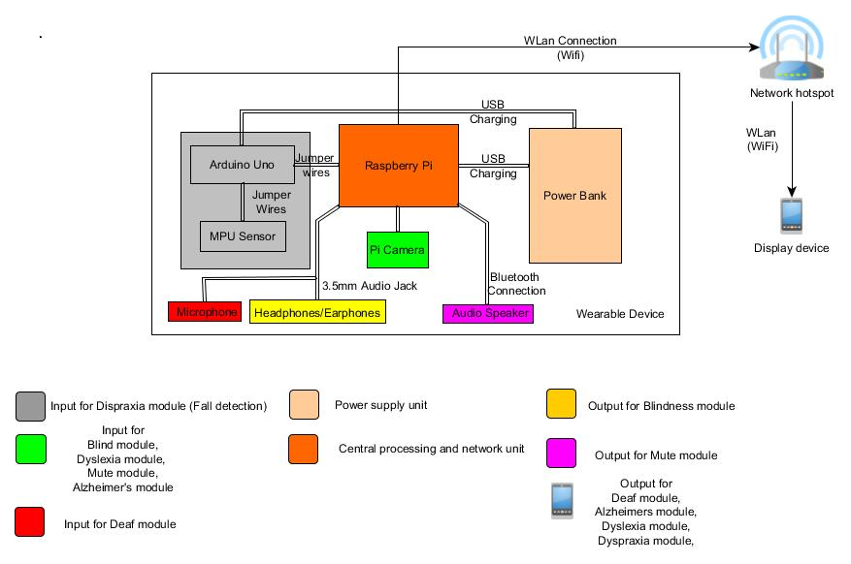

Slide 7




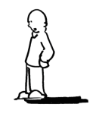
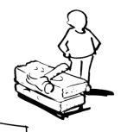



Business Model Canvas -
Key Partners -NGO and hospital for testing our product before a launch in market -Providers of various raw materials -Primary and secondary investors | Key Activities Procumbent of raw materials Development of product Distribution of product to various sales channel | Value Propositions Low product cost Customable product according to needs of different customers Updating of software every quarter |  | Customer Relationships - Regular feedback from customers and improving the product every quarter. | Customer Segments Primary customers- Differently abled person who are having different need Secondary customers - Customers who want to learn sign language or need a specific product
 | Key Resources Physical Resources Businesses equipment Patents Human resources |  |  | Channels Having a close tie up with NGO and hospitals to make customer aware of this product
Cost Structure Research and Development cost Product cost structure(Inventory Generation and management cost) Service cost structure |  |  | Revenue Streams Direct and online sales Tie up with NGO and hospitals
http://www.businessmodelgeneration.com

Slide 8









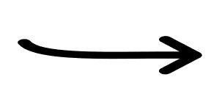

Customer provides specific requirements
Smart device delivered as per customer requirement
Customer gets the smart device
The team brainstorm and upgrades the product quarterly after the customer feedback
Customer give the feedback to the team

Slide 9





Customisation
NGO
Hospitals
Feedback from this organisation
Product specification and feedback with the help of NGO
Improved product

Slide 10



Competition
AFFORDABLE
Our product
STANDARD PRODUCT
CUSTOMIZED
EXPENSIVE

Slide 11
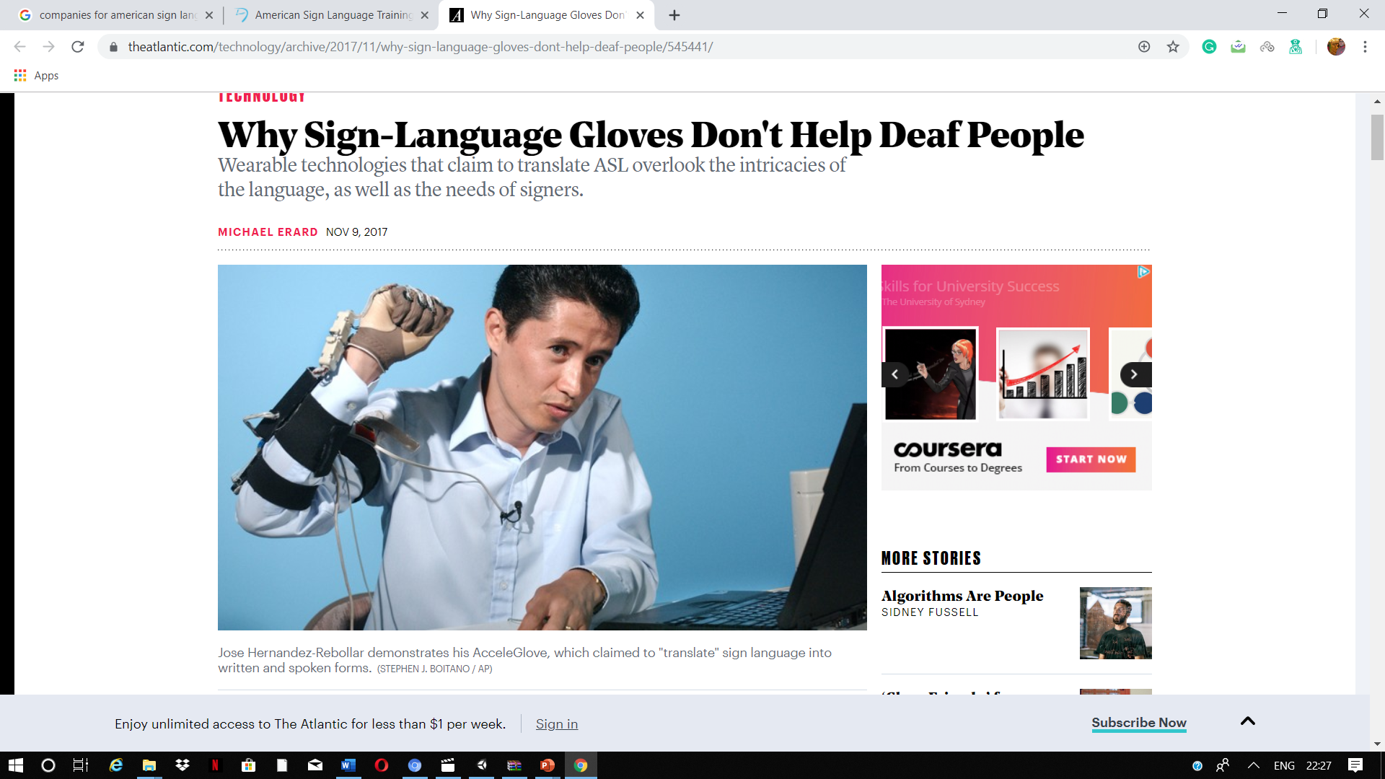

Slide 12

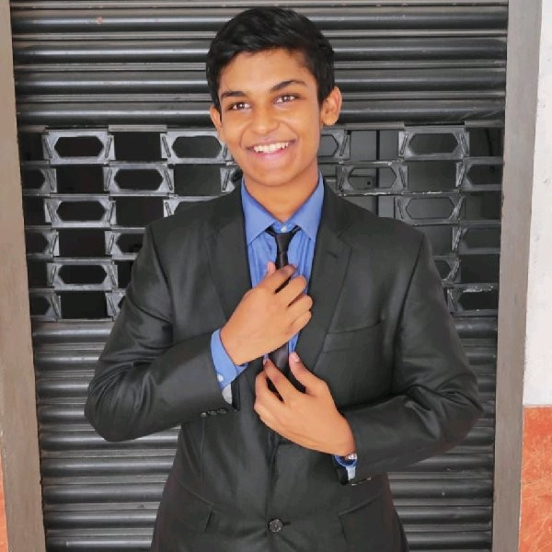
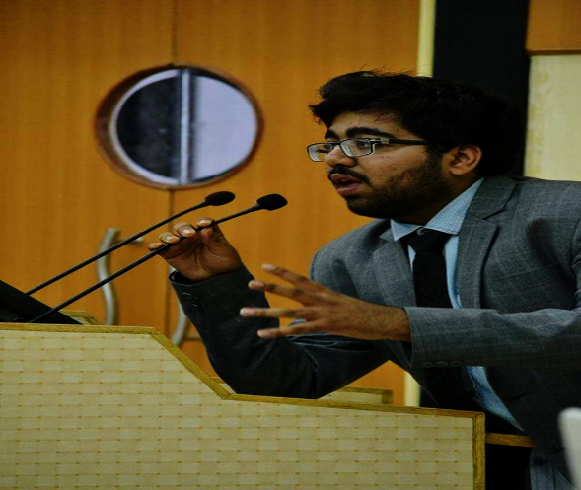
Meet the Team
3 People
SASHWATA BANERJEE
ARJUN SENGUPTA
Arjun Pardasani
Jane Doe
Jane Doe
Jane Doe
Machine learning/c.v
EMBEDDED DEVELOPER
Biomedical
Embedded developer and technical researcher at Tinnitus-Aid
President of the Electronics Club, VIT-Vellore
Passionate in robotics, computer vision and embedded systems
Technical lead at BIET organization
Electronics head at Anemoi technology
Computer vision and deep learning engineer
-Biomedical engineer interested primarily in image processing and rehabilitation engineering
-Research intern at IIT Guwahati
sashwata21@gmail.com
arjunsengupta98@gmail.com
arjunpardasani@gmail.com
9092223196
9870300622
7016027572
Notes:
© Copyright Showeet.com – Creative & Free PowerPoint Templates

